Slide 1
Early Fake News Detection
Time-Aware Graph vs. Time-Series Representations of News Propagation
Michał Pokładowski, Marek Olejniczak, Tomasz Preś, Jędrzej Pluta · Semantic Web and Social Networks · Milestone 1 · 26.10.2026
Notes:
We want to detect fake news early, while it is still spreading, using how it propagates on social media.

Slide 2

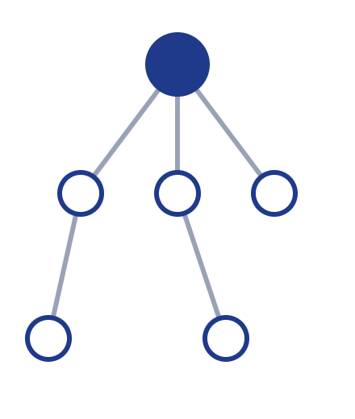
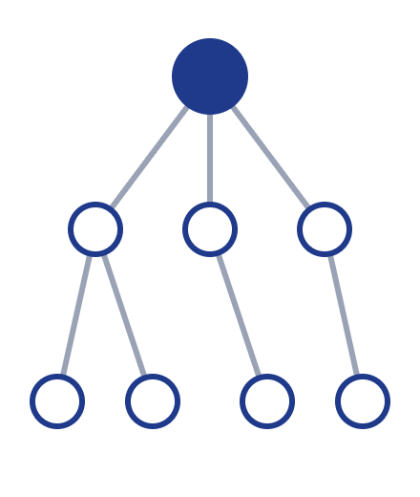
Why early detection?
Fake news spreads faster than fact-checks
Most detectors wait for the full spread
By then the damage is done
Question: how early can we tell fake from real?
t = 1 h
t = 6 h
t = 24 h
Notes:
Existing methods classify a news item after all its retweets are collected. In practice we need a decision within hours.

Slide 3

Starting point: UPFD (Dou et al., SIGIR 2021)
News + retweeting users
Graph neural network (GraphSAGE)
Propagation tree
Fake / Real
Graph = news at the root, users who retweeted it as nodes
Node features = BERT embeddings of news and users' past tweets
Accuracy: 84.6% PolitiFact, 97.2% GossipCop
Notes:
UPFD combines what the news says with who shares it. Users' historical posts act as a proxy for their preferences. Data come from FakeNewsNet: 314 PolitiFact and 5,464 GossipCop news propagation graphs.

Slide 4


Our project
Only see the first h hours (or first k users) of spreading
Graph representation
Time-series representation
Propagation tree, GraphSAGE
Retweet timestamps encoded in node embeddings
vs.
Shares ordered by time
Recurrent network (GRU)
Baselines: news text only, number of shares
Notes:
We cut each propagation graph at an early time point and compare two ways of representing the partial spread: as a graph with time-aware nodes, and as a time series. Simple baselines check that the models learn more than "how many people shared it".

Slide 5


Feasibility and plan
VERIFIED
PLAN
Data available; retweet timestamps for every node
M2–M3
M4
M5
M6
Reproduced UPFD: 96.7% on GossipCop
Data & time windows
Graph models with time
Time-series models
Comparison & report
First test: 5 users → 91% (news text only: 74%)
Notes:
We already reproduced the paper's result on GossipCop and ran a first early-detection test: after only five users the model reaches 91% accuracy, compared with 74% from the news text alone. Next we add timestamps and the time-series comparison.

